Slide 1

app-trader
team double dare

Slide 2
What’s Profitable?
Play Store, App Store, or Both?
Marketing Savings makes Both the clear answer
Longevity is Key
Highly Rated Apps Win
Free is where to be
293 inexpensive apps in both stores ($20,000 total purchase)
All About the Games

Slide 3
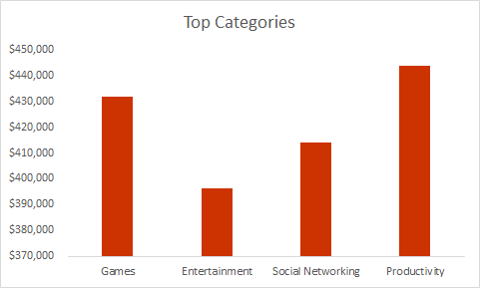
Games Worth the Scratch
Category Profit App Count
Games | $431,901 | 175
Entertainment | $396,319 | 27
Social Networking | $414,013 | 16
Productivity | $443,600 | 15
Notes:
Only apps that cost 20 k

Slide 4
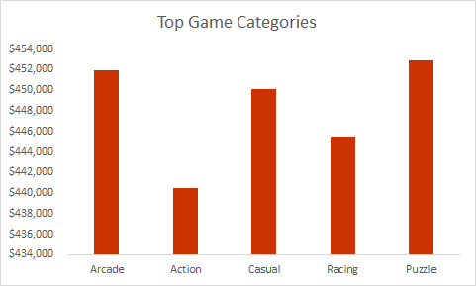
Top Game Category Profit & App Count
Category Profit App Count
Arcade | $451,923 | 26
Action | $440,435 | 23
Casual | $450,100 | 20
Racing | $445,500 | 12
Puzzle | $452,909 | 11

Slide 5
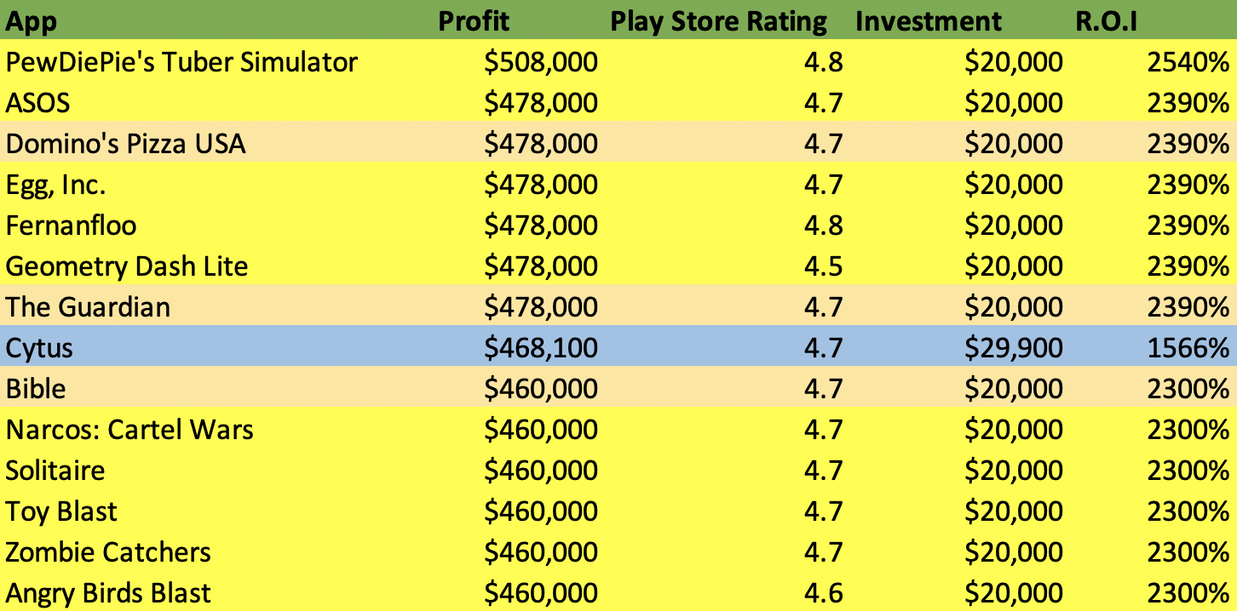

Top 10 Purchase Recommendations & Methodology
Purchase!
Inappropriate
R.O.I too low
Notes:
App store values are all already rounded so used play store values
460k
Excluded dominos guardian bible cause inappropriate
Roi for cytus is low and investment may matter for startups

